Slide 1
FREELANCE PAYROLL SYSTEM
Submitted by
Akash Chandran - 05120602019

Slide 2
INTRODUCTION

Slide 3
Problem Solution
PROPOSED SYSTEM
The proposed system is designed to eliminate all the drawbacks of the existing system. The system shall be responsible for maintaining the record & calculate the wage of the freelancer and invoices of the freelancer and bill your customers and clients as soon as the product or service is delivered or when pre-arranged milestones are reached.
This application is helpful for calculating freelancer’s weekly salary payments with an overtime bonus.
Generating payment slip which includes tax.
It is very helpful for both the user and the employer to calculate the salaries easily and keep records.
Advantages
• It is cost effective as the user control the web application himself and does not go for professional service.
• It saves time as it speeds up every aspect of the freelancer database management and payroll process with a range of automated features.
• It is secure as the freelancer’s database and the payroll process is managed by the admin in house rather than sending private information to a third party.
• Validating procedures and checks restrict user from making mistakes.
• The software is easy to use and is user friendly so no expertise is required.
• The calculations are automated so no chance of error

Slide 5
Model–view–controller (MVC)
Model–view–controller (usually known as MVC) is a software design pattern[1] commonly used for developing user interfaces that divide the related program logic into three interconnected elements. This is done to separate internal representations of information from the ways information is presented to and accepted from the user. A Model View Controller pattern is made up of the following three parts :
Model
The central component of the pattern. It is the application's dynamic data structure, independent of the user interface.[5] It directly manages the data, logic and rules of the application.
View
Any representation of information such as a chart, diagram or table. Multiple views of the same information are possible, such as a bar chart for management and a tabular view for accountants.
Controller
Accepts input and converts it to commands for the model or view.[6]
In addition to dividing the application into these components, the model–view–controller design defines the interactions between them..
The model is responsible for managing the data of the application. It receives user input from the controller.
The view renders presentation of the model in a particular format.
The controller responds to the user input and performs interactions on the data model objects. The controller receives the input, optionally validates it and then passes the input to the model.

Slide 6
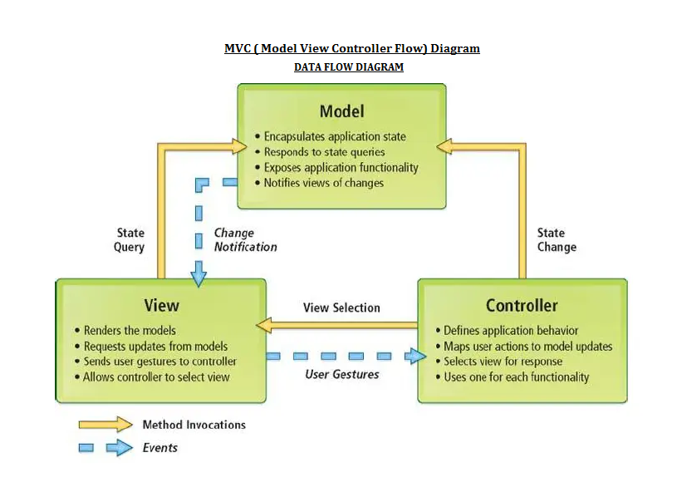

Slide 7
ER-Diagram
Hours Rate
Full Name
Company
Tax
Gross Pay
Freelancer
Receives
Weekly pay
Address
Net Pay
Overtime
Number
Hours worked
Pay Slip
Tax
Total Amount
Full Name

Slide 8
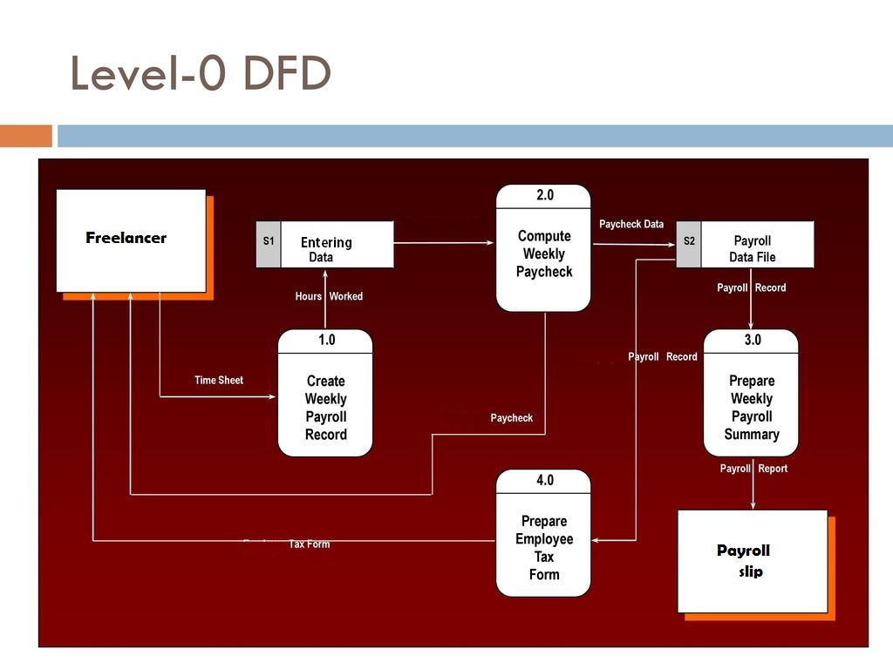

Slide 9
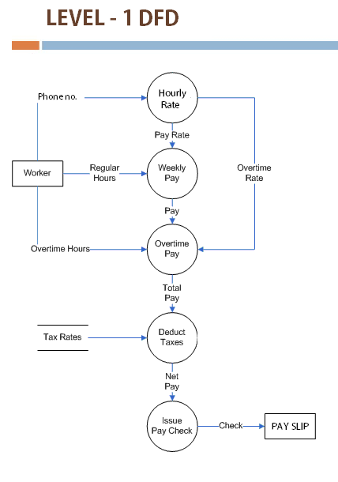

Slide 10
Modules of Freelance Payroll System
There 6 modules in this system:
1.Welcome Page
2.GUI of Freelance Payroll System-
3.Weekly salary
4. Reset
5. View payslip 6. Exit system

Slide 11
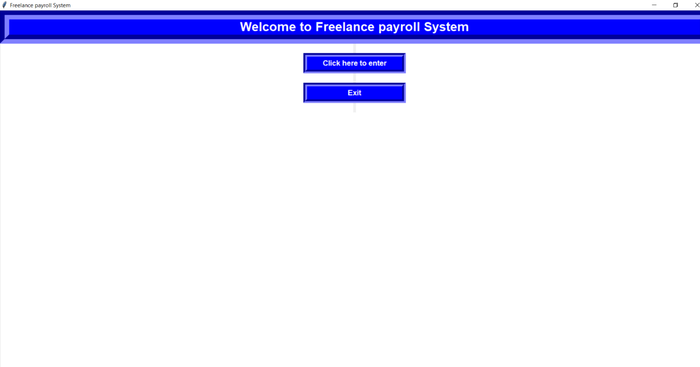
Welcome Page
The first window that opens when user click the application.
The user is provided with 2 options whether to continue or exit the application.

Slide 12
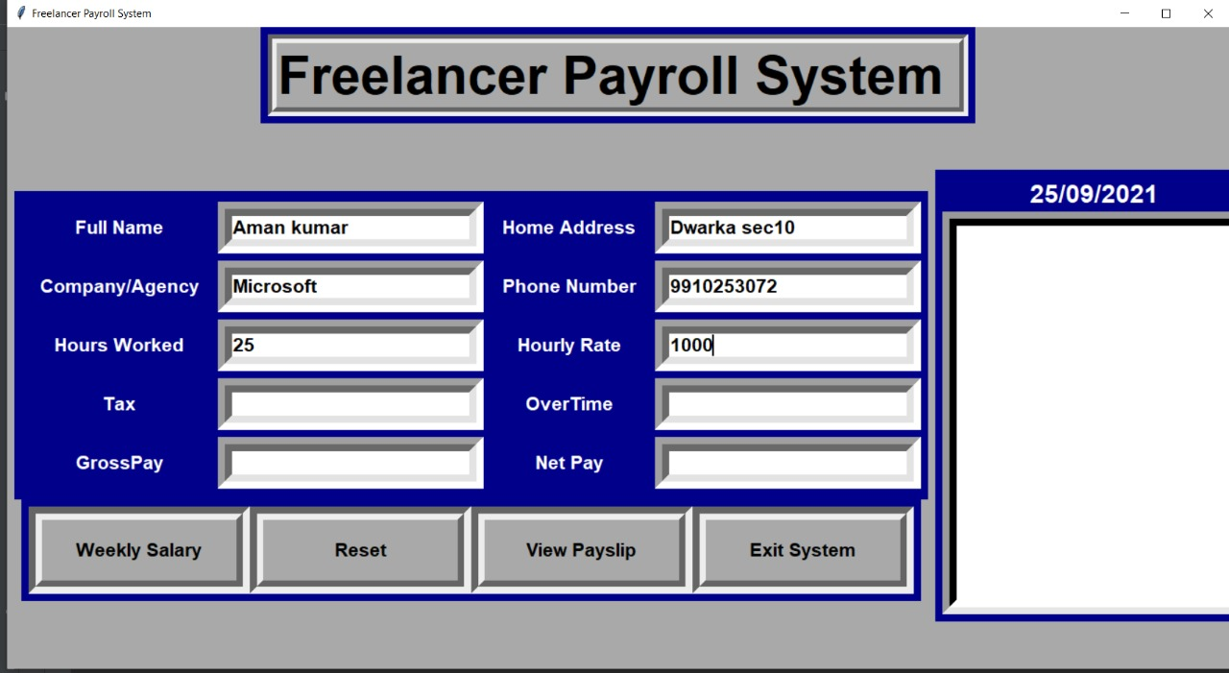
GUI of Freelance Payroll System-
The user has to enter all the required data’s such as the name of the user , address , contact information , company/ employer’s name , times worked (in hours ) , hourly wage etc

Slide 13
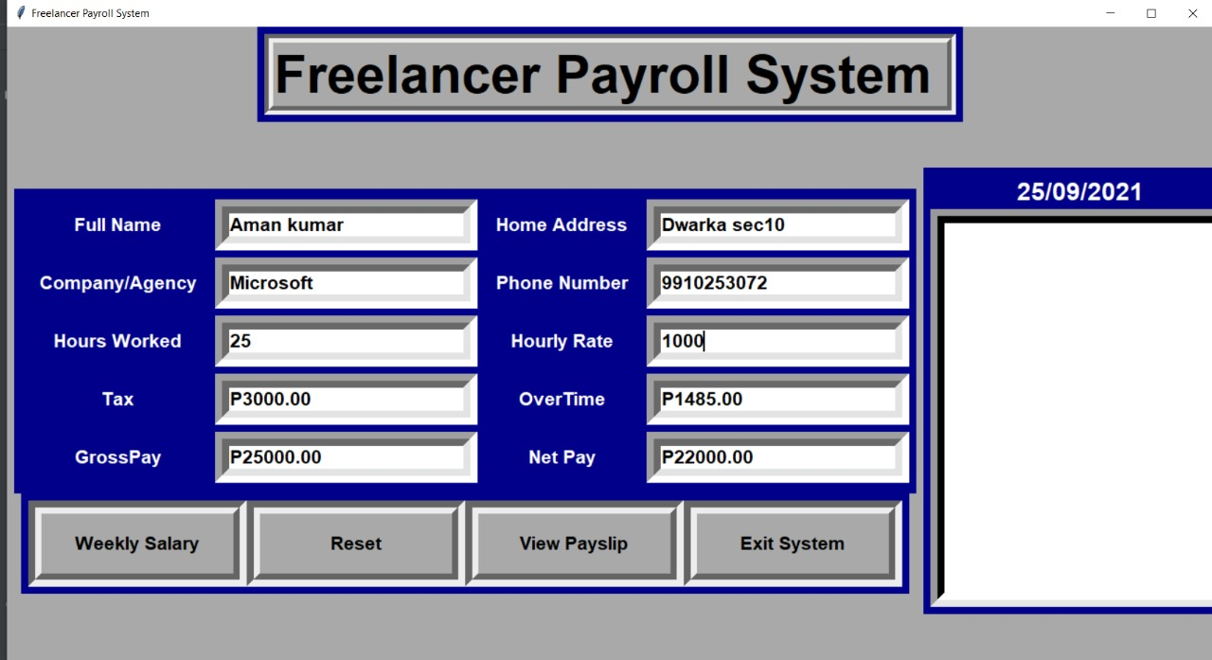
Weekly salary
After clicking this button the system calculates and shows the tax,gross salary and net salary and overtime bonus

Slide 14
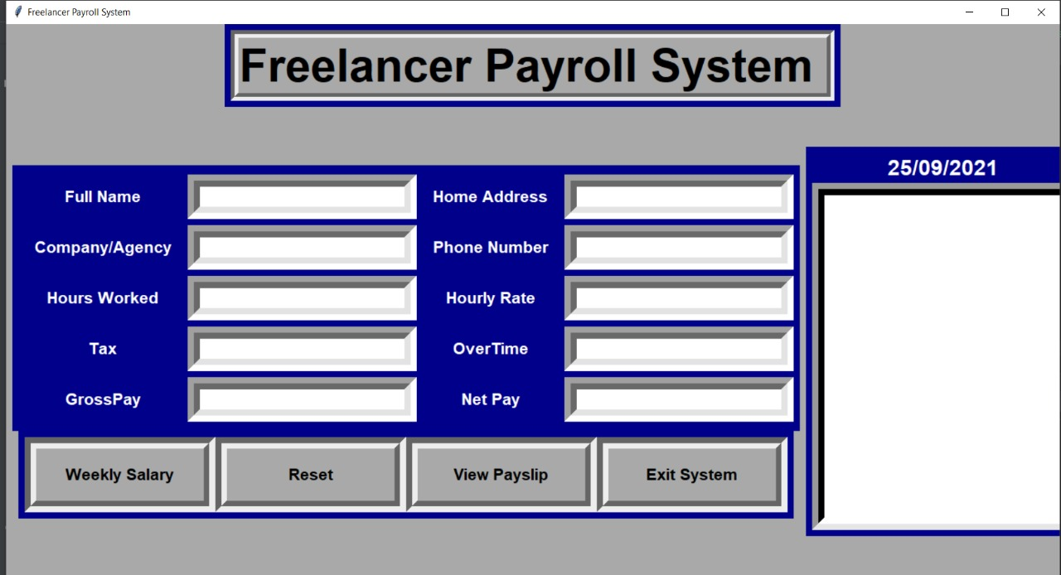
Reset
After clicking this button clear the all entries previously made in this application and allows the user to calculate weekly salary for the freelance job.

Slide 15
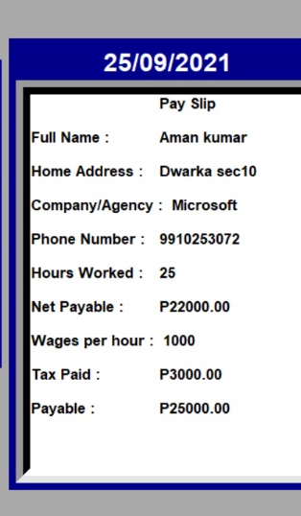
View payslip
After clicking this button it will shows the payment slip in the text box and allows the freelancer to get invoice and keep track of his/her payments.

Slide 16
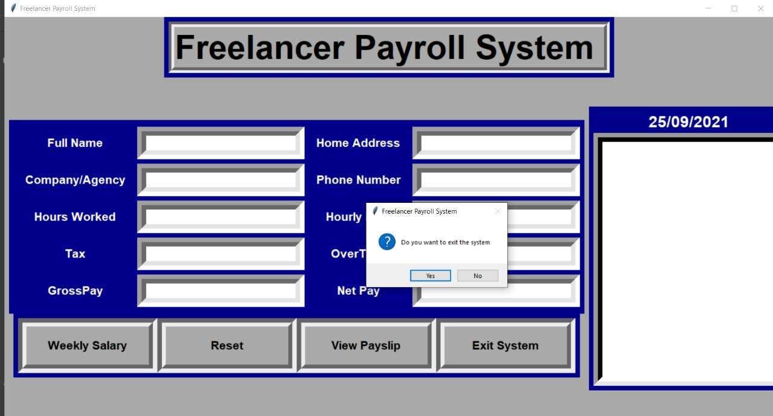
Exit system
After clicking this button it will shows one window ask yes or no to exit this application and automatically clears out the previous entries , the user has to start with new entries when he opens the application next time.

Slide 17
FUTURE SCOPE
Easy for Customers to calcite daily wages , hourly wages , weekly wages and monthly wages.
Our System enables to maintain and protect databases of all Customers.
Making Customer interactive application with authentic information.
Reaching more & more Customers.
Reaching out to Freelance job portals
Creating Customer Friendly Environment.

Slide 18
CONCLUSION
This project is built for different types of freelancer’s as the work and pay rate varies from person to person and it is user friendly. By adapting this system one can handle all freelancer’s details in a sequential manner and effectively. All the details including , Salary details, Work hours, Tasks has been stored in database successfully. Data of the employees is also secured and even if they want an employee’s detail they can get it as fast as possible. It also helps to erase all human errors occurred during manual approach. It can give a quick calculations about all payroll management. This application can update salary records and all the problems related to salary, employee attendance, overtime work, leave, etc. Therefore, this application will help to automate data of that freelancer.

Slide 19
REFERENCES

